Slide 1



Container Security
Container Enablement Workshop
Paul Clement
VP Operations & Partner
paul.clement@pinimbus.com
(760) 613-4795

Slide 2
Container Security
1. | Docker Content Trust
2. | Security Scanning
3. | Auditing
4. | Access Controls
5. | RBAC
6. | Runtime Threat Detection

Slide 3
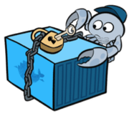
Docker Content Trust
Docker Content Trust is a new feature in Docker Engine 1.8 that makes it possible
to verify the publisher of Docker images.
Before a publisher pushes an image to a remote registry, Docker Engine signs the image locally with the publisher’s private key.
When you later pull this image, Docker Engine uses the publisher’s public key to verify that the image you are about to run is exactly what the publisher created, has not been tampered with and is up to date
Once enabled, Docker Content Trust is tied into a developer’s regular Docker workflow with no additional commands to learn
Users continue to use the same docker pull, docker push, docker build, docker create, docker run, commands they always have — only now it only operates on signed content.
How to enable Docker Content Trust?
export DOCKER_CONTENT_TRUST=1
Notes:
Move this goal to module 2

Slide 4
Docker Content Trust
Security Workflow
In a typical workflow, once developer has completed a feature,
they will push to the Continues Integration (CI) system, which will build and test the images.
The Images will the be pushed to the registry.
It is now ready for deployment to production, which will typically involve an orchestration system such as Docker’s built-in orchestration, Kubernetes, Mesos, etc. Some organizations may instead push to a staging environment before production.
In a system following security best practices, the following features and properties will be present:
Image Provenance: A secure labelling system is in place that identifies exactly and incontrovertibly where containers running on the production environment came from.
Security Scanning: An image scanner automatically checks all images for known vulnerabilities.
Auditing: The production environment is regularly audited to ensure all containers are based on up-to-date containers and both hosts and containers are securely configured.
Isolation and Least Privilege: Containers run with the minimum resources and privileges needed to function effectively. They are not able to unduly interface with the host or other containers.
Runtime Threat Detection and Response: A capability that detects active threats against a containerized application in runtime and automatically responds to it.
Access Controls: Linux security modules, such as AppArmor or SELinux, are used to enforce access controls.
Notes:
Move this goal to module 2

Slide 5
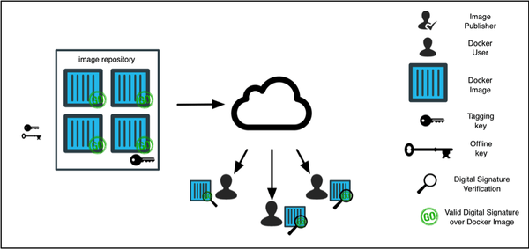
Docker Content Trust
Overview of Docker Content Trust
When images are pushed to a repository, they are signed with private keys held by the content publisher.
When a user interacts with the image for the first time, they establish trust with that publisher and then all subsequent interactions require a valid signature verification from that same publisher.
This is similar to the trust on first use model of SSH that developers are familiar with, except for the added security benefit of the initial trust being established over HTTPS using the corresponding public PKI.
Content Trust Key Structure
Docker Content Trust has two distinct keys
The Tagging Key is generated for each new repository the publisher owns. They can be exported and shared with any person/system that needs the ability to sign content for this repository.
The Offline Key is the most important key, since it is the root of trust for your repository. Different repositories can use the same Offline key. You will only need this key if you are creating a new repository or rotating an existing key.
Notes:
Move this goal to module 2

Slide 6
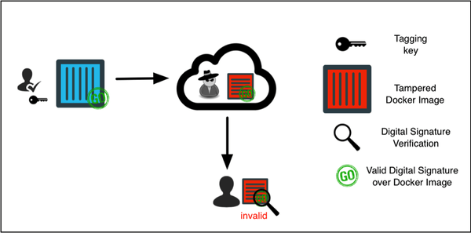
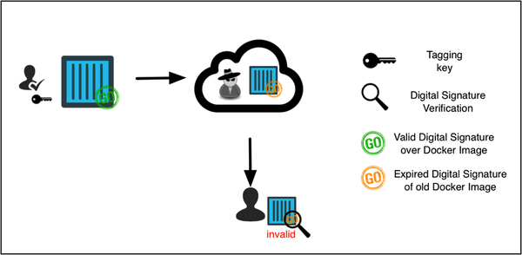
Docker Content Trust
Protection Against Image Forgery
Once trust is established, one of the guarantees that Docker Content Trust provides is the ability to withstand a malicious actor with a privileged network position
This means that in the event a registry is compromised, the malicious actor cannot tamper with the content and successfully serve it to the user.
In this situation, every docker command run by a user will hard fail with a message stating that it was not able to verify the content.
Protection Against Replay Attacks
Replay attacks are a common problem with designing secure distributed systems, where previously valid payloads are replayed to trick another system.
The same problem exists in software update systems, where old versions of signed software can be presented as the most recent. If a user is fooled into installing an older version of a particular software, the malicious actor can make use of known security vulnerabilities to compromise the user’s host.
Docker Content Trust uses the Timestamp key when publishing the image, providing protection against replay attacks and ensuring the user is receiving the most up to date content.
Notes:
Move this goal to module 2

Slide 7
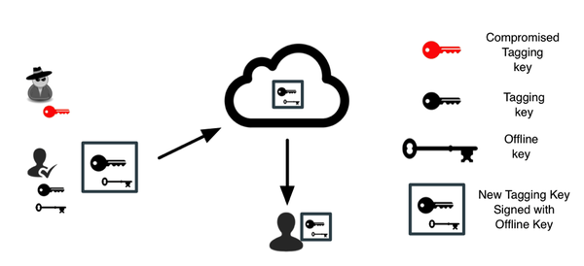
Docker Content Trust
Protection Against Key Compromise
The illustration below depicts a scenario where the Tagging key has been compromised.
The online nature of the Tagging key and the fact that it is needed every time new content gets pushed to a repository makes this key inherently more exposed than the Offline key.
If this were a system that attempted to ensure integrity of data by using a single key, there would be no path forward to recover from an a key compromise.
Docker Content Trust utilizes TUF to separate responsibilities across a hierarchy of keys such that loss of any particular key (except the Offline role) by itself is not fatal to the security of the system.
Docker Content Trust enables the publisher to rotate the compromised key transparently to the users and effectively remove the compromised key from the system
publishers can even proactively rotate this key and protect themselves from undetected key compromises.
Notes:
Move this goal to module 2

Slide 8
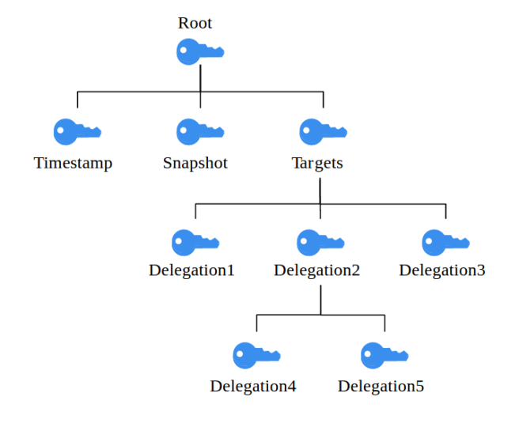
Docker Content Trust
The Update Framework (TUF)
Root key – The root key acts as the root of trust in TUF. It’s the key with the longest expiration date as well as the highest privileges, and it’s only job is to sign the other keys in the system, which is why it should be kept offline and secure. More precisely, the root role signs a file called root.json, which is required by the TUF specification and lists the currently valid public keys for all the other keys in the system.
Snapshots key – This key signs the snapshot.json file, which contains a list of all currently valid metadata files (i.e. file name, file size and hash) except from timestamp.json. In other words, this file gives us a “snapshot”, comprising everything in our repository that should be considered a part of the latest revision of our software. This idea of taking “snapshots” underlines one of TUF’s core concepts, which is thinking in collections instead of single files. In this way, we can protect ourselves from Mix-and-match attacks.
Timestamp key – The timestamp key signs the timestamp.json file, which in turn indicates the currently valid snapshot.json file by hash, file size and version number. It has the shortest expiration time and the least privileges in the system, since it is kept online and therefore must be considered very vulnerable. Timestamp.json gets re-signed in regular intervals.
Targets key – This key is finally responsible for verifying the files we want to protect (i.e. the “target” files). It signs targets.json, a file which lists our target files by file name, file size and hash and therefore ensures their integrity. The targets role allows for delegating responsibility to one or more subordinated roles, meaning that they can also sign a subset of the present target files (e.g. a all files in a certain subdirectory). The advantage that comes with delegations is that the owner of the targets key doesn’t have to share it with others. Instead, the targets role signs one or more delegation keys, which only apply to the files it wants to delegate trust for. In this way, there’s no possibility for the delegated role to sign any content it isn’t supposed to.
TUF defines a hierarchy of different keys with different privileges and varied expiration dates instead of relying on a single key
These keys are bound to specific roles, the owner of the root key for example earns the root role within the system
TUF determines a set of metadata files which must be present at a repository’s top level directory.
Notes:
Move this goal to module 2

Slide 9
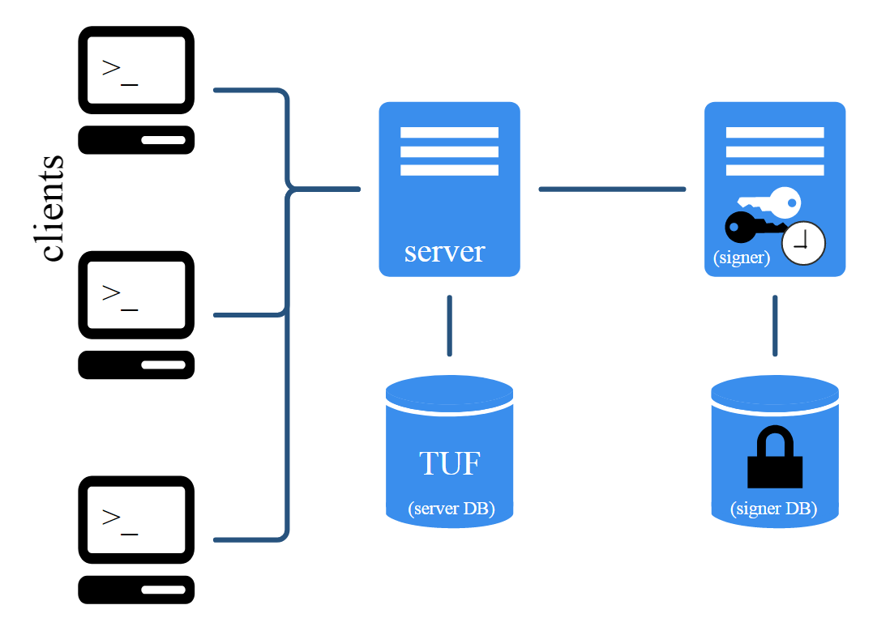
Docker Content Trust
Notary: Secure content distribution for all
Docker Content Trust is enabled through an integration of Notary into Docker Engine.
Notary is a utility for securely publishing and verifying content that is distributed over any insecure network.
Notary can be downloaded and implemented by anyone who wants to digitally sign and verify their arbitrary collections of content.
The primary objective of Notary is to leapfrog the status-quo of software distribution, and package modern security guarantees within a simple command-line utility.
Notary server
stores and serves metadata for the Notary clients.
makes sure that the latest versions of the metadata files are fetched from the TUF database and delivered to the client.
checks all metadata that is uploaded by clients for validity as well as legal signatures. As soon as new valid metadata is supplied by a client, the Notary server also generates new timestamp metadata, which gets signed by Notary signer.
Notary signer
is much like a “back-end”, storing the private timestamp key (and possibly the snapshot key) and waits for the Notary server’s signing requests.
The Notary server is the only component which directly connects to the signer and therefore acts more as a “front-end”.
Notes:
Move this goal to module 2

Slide 10
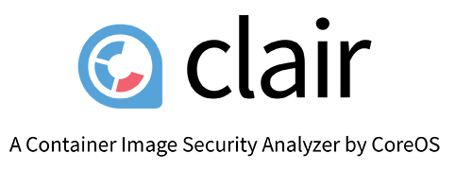
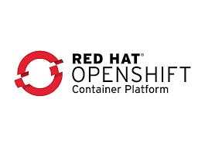
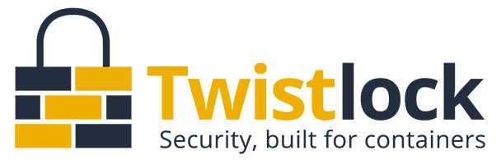
Security Scanning
Docker Security Scanning
formerly known as Project Nautilus
compares the contents of a container, by inspecting the binary packages in that container against the Common Vulnerabilities and Exposures (CVE) database
The CVE is a “dictionary” of known information security vulnerabilities (https://cve.mitre.org/about/index.html)
Steps to use Docker Security Scanning with Docker Hub private repositories-
Step 1 - Create a private Hub repo
Step 2 - Pull an image
Step 3 - Tag and push an image
Step 4 - View scan results
Step 4 - Clean-up
Red Hat container image scanner
https://github.com/docker/labs/tree/master/security/scanning
Notes:
Move this goal to module 2

Slide 11
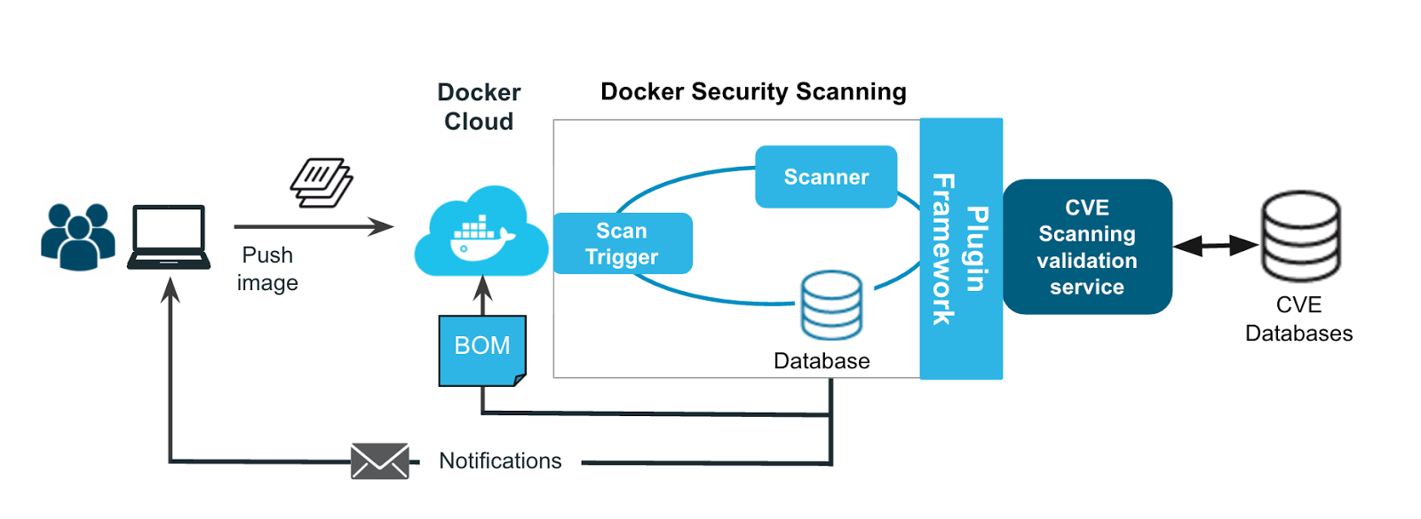
Security Scanning
Docker Security Scanning
A team of developers may build a Docker image and then push it to the Docker Cloud.
Before it is stored in the cloud, the image will be scanned for software packages with known vulnerabilities.
It generates a list of all the software packages and libraries it can identify and cross-references them against the CVE list.
The developer gets a notification if any vulnerabilities are in the image.
The scanning can be easily integrated into continuous integration/continuous delivery (CI/CD) workflows
Notes:
Move this goal to module 2

Slide 12
Auditing
You can use all your existing arsenal and procedures your are familiar to audit the application running in the containers (file permissions, logs, etc.) but what about the containers, images, dockerfiles, docker servers or even the clustering and orchestration platform?
Tools
Docker Bench for Security
OpenSCAP Container Compliance
CoreOS Clair
Banyan Collector:
Lynis:
Twistlock
Bitnami Stacksmith
Dockscan
Drydock
Batten
Scalock
Considerations for this particular audit:
Check if images and packages inside images are up-to-date and are free of security vulnerabilities.
Audit automatization, we must be able to automatize all checks. That will save us a precious time and we can run it as often as we require, forget about to do it manually unless you are just testing or learning.
Container links and volumes. If you use read-only filesystem in your running container “docker diff” can help you to find issues.
The bigger an image is the harder the audit will be, reduce as much as you can the size of your images.
The host kernel is the shared point between all containers in the same server, keep that kernel up-to-date.
Banyan Collector, CoreOS Clair, and OpenSCAP Container Compliance can all check containers or images –either locally or within a registry -- for known vulnerabilities.
CoreOS Clair and Banyan Collector require additional work to install but provide additional coverage and Clair provides an API for process automation
Notes:
Move this goal to module 2

Slide 13
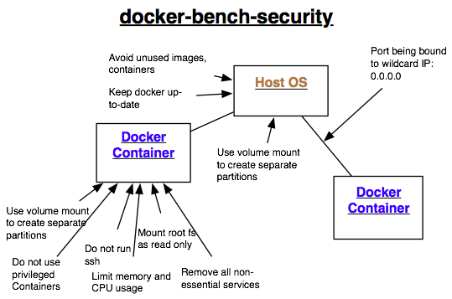
Auditing
docker-bench-security
is a script that checks for dozens of common best-practices around deploying Docker containers in production.
Those checks are based on all recommendations taken from the CIS Docker 1.6 Benchmark document.
https://github.com/docker/docker-bench-security
Running Docker Bench for Security
run your hosts against the Docker Bench for Security is by running our pre-built container
Notes:
Move this goal to module 2

Slide 14
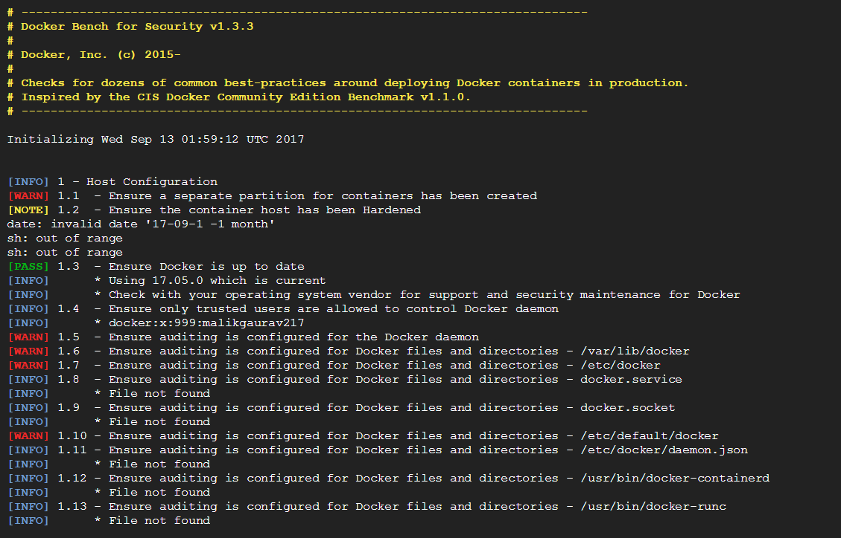
Auditing
Running Docker Bench for Security
Run hosts against the Docker Bench for Security is by running pre-built container (https://hub.docker.com/r/docker/docker-bench-security/)
Docker bench requires Docker 1.10.0 or later in order to run.
$ docker run -it --net host --pid host --cap-add audit_control \
-e DOCKER_CONTENT_TRUST=$DOCKER_CONTENT_TRUST \
-v /var/lib:/var/lib \
-v /var/run/docker.sock:/var/run/docker.sock \
-v /usr/lib/systemd:/usr/lib/systemd \
-v /etc:/etc --label docker_bench_security \
docker/docker-bench-security
Building Docker Bench for Security
$ git clone https://github.com/docker/docker-bench-security.git
$ cd docker-bench-security
$ docker build -t docker-bench-security .
$ docker run -it --net host --pid host --cap-add audit_control \
-e DOCKER_CONTENT_TRUST=$DOCKER_CONTENT_TRUST \
-v /var/lib:/var/lib \
-v /var/run/docker.sock:/var/run/docker.sock \
-v /usr/lib/systemd:/usr/lib/systemd \
-v /etc:/etc --label docker_bench_security \
docker-bench-security
Notes:
Move this goal to module 2

Slide 15
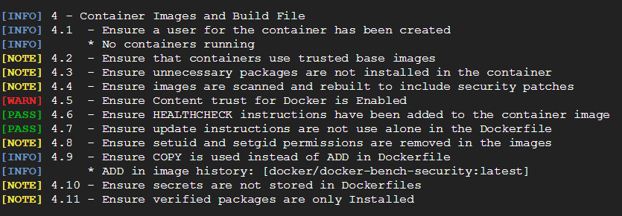
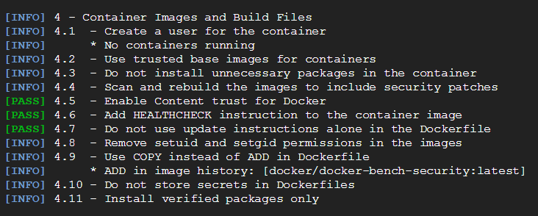
Auditing
# enable Content trust for Docker
$ export DOCKER_CONTENT_TRUST=1
Notes:
Move this goal to module 2

Slide 16
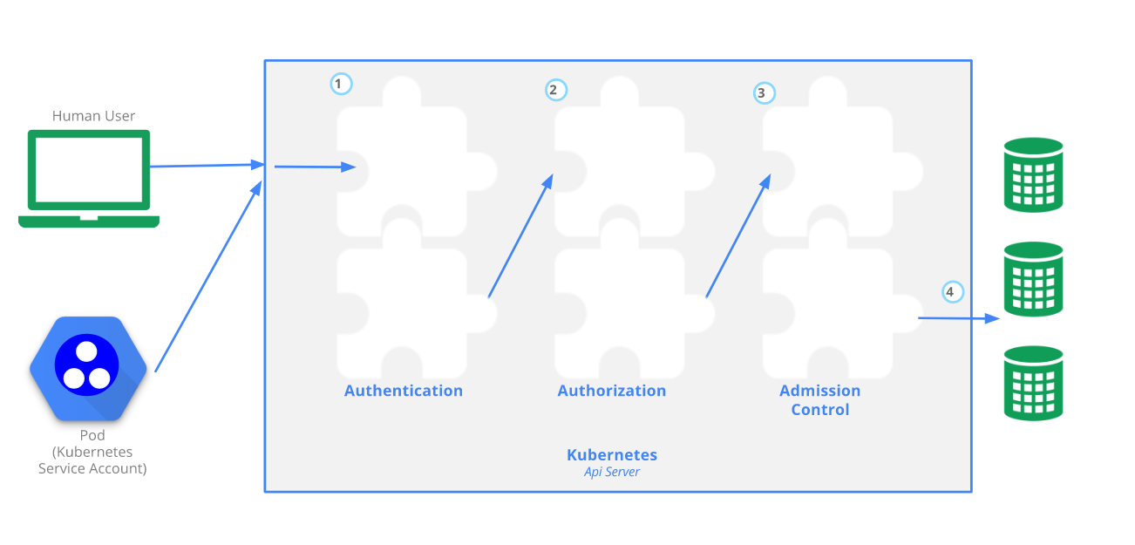
Access Controls To Kubernetes API
Users access the Kubernetes API using kubectl, client libraries, or by making REST requests. Both human users and Kubernetes service accounts can be authorized for API access. When a request reaches the API, it goes through several stages, illustrated in the following diagram:
Notes:
https://kubernetes.io/docs/admin/accessing-the-api/

Slide 17
Access Controls - Authentication
All requests to API server goes through the Authentication step. This is shown as step 1 in the diagram
The cluster creation script or cluster admin configures the API server to run one or more Authenticator Modules. Authentication modules include Client Certificates, Password, and Plain Tokens, Bootstrap Tokens, and JWT Tokens.
Multiple authentication modules can be specified, in which case each one is tried in sequence, until one of them succeeds.
If the request cannot be authenticated, it is rejected with HTTP status code 401. Otherwise, the user is authenticated as a specific username, and the user name is available to subsequent steps to use in their decisions.
Notes:
https://kubernetes.io/docs/admin/accessing-the-api/

Slide 18
Access Controls - Authentication
All Kubernetes clusters have two categories of users: service accounts managed by Kubernetes, and normal users.
Normal users are assumed to be managed by an outside, independent service. An admin distributing private keys, a user store like Keystone or Google Accounts, even a file with a list of usernames and passwords. In this regard, Kubernetes does not have objects which represent normal user accounts. Regular users cannot be added to a cluster through an API call.
In contrast, service accounts are users managed by the Kubernetes API. They are bound to specific namespaces, and created automatically by the API server or manually through API calls. Service accounts are tied to a set of credentials stored as Secrets, which are mounted into pods allowing in cluster processes to talk to the Kubernetes API.
API requests are tied to either a normal user or a service account, or are treated as anonymous requests. This means every process inside or outside the cluster, from a human user typing kubectl on a workstation, to kubelets on nodes, to members of the control plane, must authenticate when making requests to the API server, or be treated as an anonymous user.
Notes:
https://kubernetes.io/docs/admin/accessing-the-api/

Slide 19
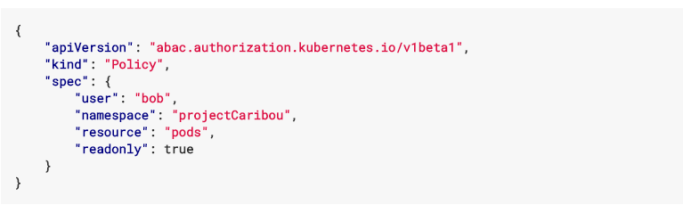
Access Controls - Authorization
After the request is authenticated as coming from a specific user, the request must be authorized. This is shown as step 2 in the diagram.
A request must include the username of the requester, the requested action, and the object affected by the action. The request is authorized if an existing policy declares that the user has permissions to complete the requested action.
For example, if Bob has the policy below, then he can read pods only in the namespace projectCaribou:
Notes:
https://kubernetes.io/docs/admin/accessing-the-api/

Slide 20
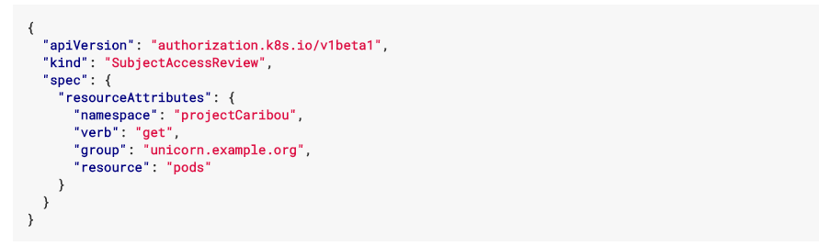
Access Controls - Authorization
If Bob makes the following request, the request is authorized because he is allowed to read objects in the projectCaribou namespace:
If Bob makes a request to write (create or update) to the objects in the projectCaribou namespace, his authorization is denied. If Bob makes a request to read (get) objects in a different namespace such as projectFish, then his authorization is denied.
Notes:
https://kubernetes.io/docs/admin/accessing-the-api/

Slide 21
Access Controls – Admission control
An admission control plug-in is a piece of code that intercepts requests to the Kubernetes API server prior to persistence of the object, but after the request is authenticated and authorized.
Each admission control plug-in is run in sequence before a request is accepted into the cluster. If any of the plug-ins in the sequence reject the request, the entire request is rejected immediately and an error is returned to the end-user.
Admission control plug-ins may mutate the incoming object in some cases to apply system configured defaults. In addition, admission control plug-ins may mutate related resources as part of request processing to do things like increment quota usage.
Once a request passes all admission controllers, it is validated using the validation routines for the corresponding API object, and then written to the object store (shown as step 4).
Notes:
https://kubernetes.io/docs/admin/admission-controllers/

Slide 22
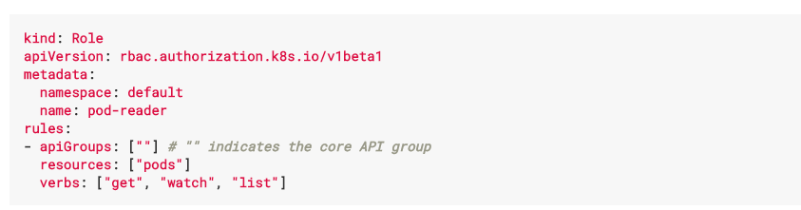
Access Controls - RBAC
Role-Based Access Control (“RBAC”) uses the “rbac.authorization.k8s.io” API group to drive authorization decisions, allowing admins to dynamically configure policies through the Kubernetes API.
ROLE - In the RBAC API, a role contains rules that represent a set of permissions. Permissions are purely additive (there are no “deny” rules).
Notes:
https://kubernetes.io/docs/admin/accessing-the-api/

Slide 23
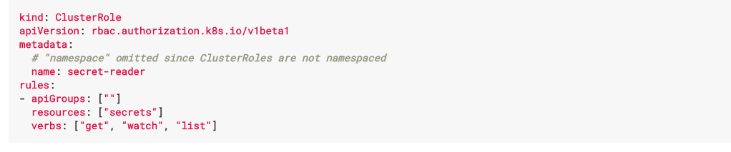
Access Controls - RBAC
CLUSTER ROLE – A ClusterRole can be used to grant the same permissions as a Role, but because they are cluster-scoped, they can also be used to grant access to:
cluster-scoped resources (like nodes)
non-resource endpoints (like “/healthz”)
namespaced resources (like pods) across all namespaces
Notes:
https://kubernetes.io/docs/admin/authorization/rbac/

Slide 24
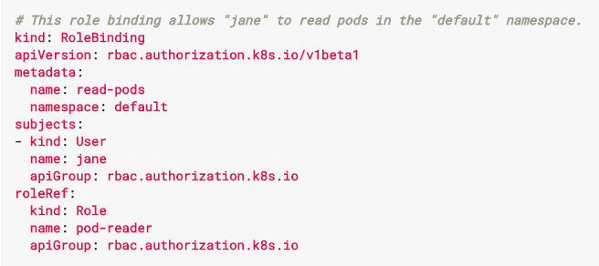
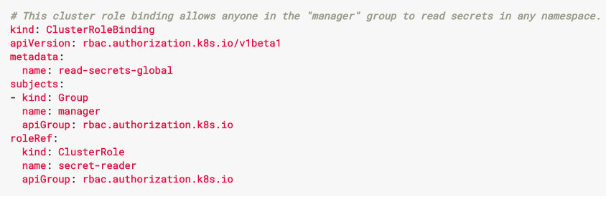
Access Controls - RBAC
ROLE BINDING – A role binding grants the permissions defined in a role to a user or set of users. It holds a list of subjects (users, groups, or service accounts), and a reference to the role being granted. Permissions can be granted within a namespace with a RoleBinding, or cluster-wide with a ClusterRoleBinding.
Notes:
https://kubernetes.io/docs/admin/authorization/rbac/
https://docs.bitnami.com/kubernetes/how-to/configure-rbac-in-your-kubernetes-cluster/

Slide 25

THANK YOU!

